Slide 1
Behavioral Health:
Peer Workforce Training Program
November 2023
Notes:
BROOKE

Slide 2
The Workforce Investment Board
About Worksystems:
Non-profit agency designated by the Governor to coordinate Federal, State and local workforce investment funds.
We serve the Greater Portland Metro Area - Multnomah and Washington County.
Our budget is ~$35MM annually in grants for training and employment activities.
We work with our Aligned Partner Network (40+ community-based and culturally-specific organizations) and WorkSource Centers (America’s Job Centers) to manage investments in the region.
We design and coordinate workforce development programs and services delivered through a network of partners to help people get the skills, training and education they need to go to work or to advance in their careers.
Our partners include employers, labor groups, government, community colleges, high schools, community-based and economic development organizations.
Since 1998, Worksystems has invested over $300 million in our community.
About Business Services and Sector Strategies:
We collaborate with SW Washington and Clackamas County workforce boards.
We have a regional framework and definition of a quality job that guides our work that includes characteristics beyond pay (i.e benefits, predictable schedule, worker safety/ work engagement, accessible hiring, training and advancement opportunities, etc)
We identify and engage targeted industries that are high growth sectors in the region and have high job quality characteristics.
We convene industry to design workforce investments and create access to our priority customers in our WorkSource Centers and Community Programs.
Notes:
BROOKE

Slide 3
National and State Context
PEER WORKERS: Emerging Healthcare field called Peer-Delivered Services based on an important evidence-based model of care for addiction and mental health that includes empathy and support from a practitioner that has lived experience with recovery from substance abuse disorder.
OREGON HEALTH AUTHORITY (OHA): From 2007-2020 OHA integrated state-approved peer support certification trainings state-wide and a Traditional Health Worker Registry - Where all peer support workers are registered.
MEASURE 110: In November 2020, Oregon voters passed the Drug Addiction Treatment and Recovery Act - Behavioral Health Resource Networks (BHRNs) were established to provide trauma-informed and culturally specific community-based services and support to people with substance use disorders.
MEASURE 110 FUNDING: Various Behavioral Health Resource Networks and employers were funded by Measure 110 to hire peer workers to address the growing gap between the need for services and the number of peer workers necessary to meet the demand for services.
STATE-WIDE CHALLENGES: This emerging field and workforce have experienced many challenges as reported by Oregon Health Authority’s (OHA) Behavioral Health Workforce Wage Study Report 2022, resulting in a shortage of peer workers and providers.
Notes:
PEER WORKERS: Peer worker practitioners are part of an emerging Healthcare field called Peer-Delivered Services. Formally established in 2007, peer workers are based on an important evidence-based model of care for addiction and mental health that includes empathy and support from a practitioner that has lived experience with recovery from substance abuse disorder.
MEASURE 110: In November 2020, Oregon voters passed the Drug Addiction Treatment and Recovery Act - Behavioral Health Resource Networks (BHRNs) were established to provide trauma-informed and culturally specific community-based services and support to people with substance use disorders.
WORKFORCE FUNDING: Various Behavioral Health Resource Networks and employers were funded by Measure 110 to hire peer workers to address the growing gap between the need for services and the number of peer workers necessary to meet the demand for services.
WORKFORCE CHALLENGE: This emerging field and workforce have experienced many challenges as reported by Oregon Health Authority’s (OHA) Behavioral Health Workforce Wage Study Report 2021, resulting in a shortage of peer workers and providers.

Slide 4
State of the Peer Workforce
Current Challenges
Growing gap between the need for services and number of peer workers, especially for communities of color.
No existing talent pipeline to fill the number of open positions in the field, especially for number of Bilingual and Culturally-Specific staff needed.
Peer workers are often early in their recovery and this can interrupt their levels of workforce readiness.
Employers and certifying bodies are lessening the requirements and qualifications resulting in more certified and working peer workers who have not been in recovery long enough and/or don’t have the employment support needed for successful employment.
State approved training programs are consistent in curriculum content, but vary on the depth of each topic and vary on the final exams to complete the training program.
Recommendations
More effective Ethics training is needed, including common scenarios and role play delivered by a Peer Mentor.
Increase knowledge and awareness of the field to increase more informed and suitable candidates to enter.
Raise wages and pay equity compared to physical health practitioners.
Include Self Care trainings and resources.
Integrate supervision best practices including - Co-Supervisions Models.
Map out career pathways for Peers including Non-Degree, Degree and Administrative opportunities.
Increase workforce readiness and support through industry-specific career coaching, training and ongoing support during employment.
Source- MHAAO, OHA
Notes:
The occupational focus of this program is for entry-level peer workers that share the same knowledge, skills, abilities and qualifications needed by employers.
Program is designed to create a talent pipeline of Peer-Support Workers- an evidence-based model of care that requires the practitioner have experience with recovery from substance abuse disorder.
Formally recognized in 2007 as a Healthcare field, but peer-support workers have a long history in Indigenous communities, Alcoholics Anonymous, and faith-based recovery ministries where participants received empathy and support from others with life experiences.
Workforce shortages have caused employers to reduce the requirements and qualifications to be hired, including not being certified prior to hire, and the peer workers lack the knowledge, skills, abilities and certifications to be successful.

Slide 5
Program Background
STEERING COMMITTEE: In 2023, Worksystems formed the Behavioral Health Steering Committee (steering committee) comprised of behavioral health employers, associations and certifying bodies to identify and address the workforce challenges faced by the industry to meet their peer workforce needs.
CHALLENGE IN PORTLAND / WASHINGTON COUNTY: Employers have been unable to hire and retain qualified peer workers to fill their open positions, especially for bilingual and culturally specific service delivery.
OCCUPATIONS: The steering committee identified a variety of entry-level peer-worker occupations that shared the same knowledge, skills, abilities and qualifications needed by employers funded by Measure 110.
PEER WORKFORCE TRAINING PROGRAM: Worksystems facilitated the steering committee to identify universal qualifications, Peer Worker candidate profiles, industry-specific workforce preparation needs and relevant existing state-approved Certified Recovery Mentor certification and training.
INDUSTRY COMMITMENT: All hiring employers will sign a Memorandum of Understanding (MOU) committed to the goals of the program. Employer Steering Committee represents range of industries in Behavioral Health:
​Non-Profit
Community-Based Organizations (CBOs)
Culturally-Specific CBOs​
Hospitals​
Recovery / Treatment Centers​
Housing and Residential Centers

Slide 6
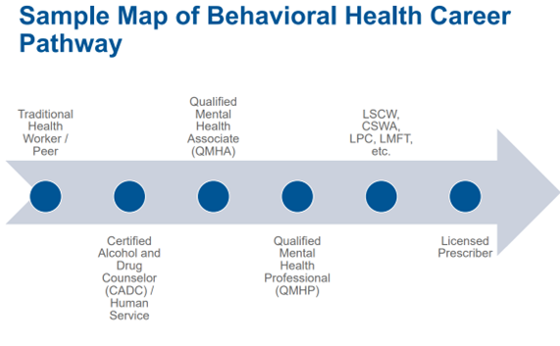
Peer Worker Occupations in Scope of Program
Positions funded by Measure 110
Peer Worker Occupations Served by the Peer Workforce Program
Certified Recovery Mentor
Peer Support Specialist
Peer Mentor
Forensic Peer Support Specialist
Outreach Peer Support Specialist
Culturally Specific Recovery Support
Recovery Navigator
Barracks Support Staff
Residential Support Specialist
Residential Aide /Counselor
Patient Care Assistant
Street Outreach Worker
Engagement Specialist
Workforce Navigator
These are current OPEN positions from our steering committee.
Estimated 80+ open positions over next 6-12 months.
2. Entry-level and Accessible
3. Requires a Certified Recovery Mentor (CRM) credential
4. In-Demand and Open Positions

Slide 7
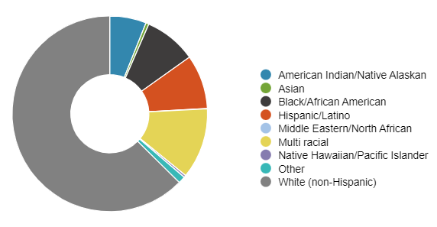
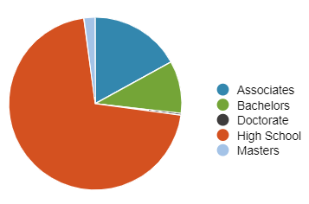
Local Challenges
Active Certifications - MultCo and WashCo
Current MHACBO CRM Analytics
Relatively high number of new and active CRM certifications but still unable to meet demand for services.
No coordination among employer regarding qualifications and suitability - to each their own.
No coordinated marketing to attract candidates with the right experience, background and competencies to join the field.
No systemized career path for peer workers to advance in their positions.
Not enough Bilingual and BIPOC practitioners to meet the demand for services
CRM / Peer Workers account for 40% of the Ethics complaints reported to MHACBO, although they only represent 20% of the occupations certified by MHACBO.
CRM / Peer Workers have the lowest median years working in social services compared to other behavioral health occupations - 3.1 years - primarily driven by:
Low wages and lack of equity compared to physical health providers.
Career and educational barriers
Work environment stressors and burnout
Active Certifications - MultCo and WashCo
887
New CRMs (30 Days)
97
Race and Ethnicity
Education
Source- Steering committee, MHACBO

Slide 8
Peer Workforce Training Program Overview
Objectives:
To establish a systemized program of outreach, recruitment, and occupational training to serve as a pipeline of highly skilled and trained peer workers to meet the workforce needs of Behavioral Healthcare employers (Grant 110 recipients). To address the shortage of bilingual and BIPOC practitioners. To increase the prestige, pay, recruitment and retention of Behavioral Healthcare employees.
Partners:
Worksystems
Behavioral Health Employers in Washington and Multnomah County
Oregon Health Authority (OHA)
Mental Health Association Certification Board of Oregon (MHACBO)
Mental Health and Addiction Association of Oregon (MHAAO)
Oregon Behavioral Health Council (OBHC)
Clackamas Workforce Partnership Behavioral Health Consortium.
Prioritized Participants:
People with at least one year of recovery from substance use disorder - BIPOC and Bilingual participants will be prioritized in enrollment - and those meet Ideal Candidate Profile
Notes:
BROOKE

Slide 9
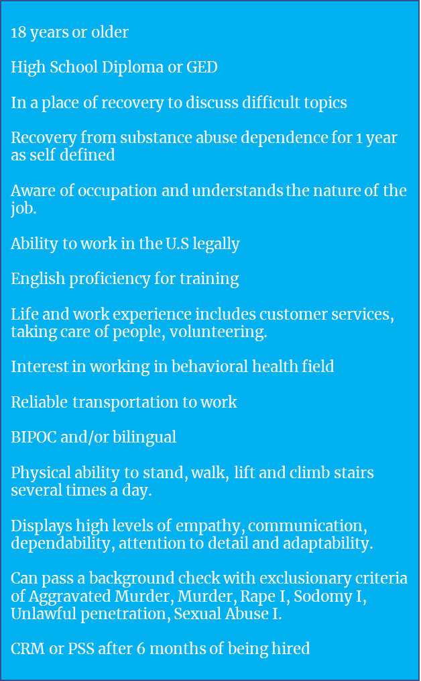
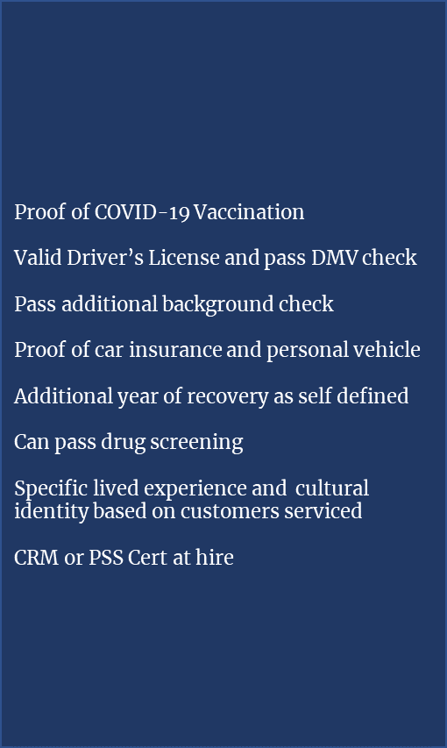
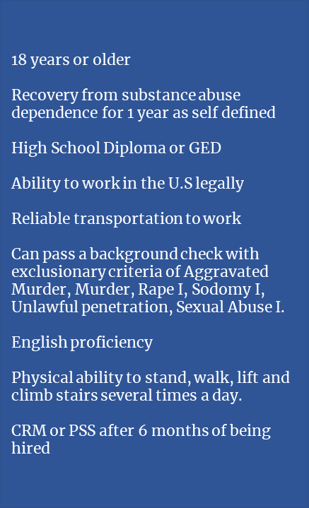
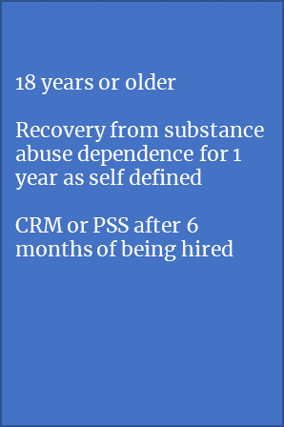

Slide 10
Goals of the Program
Goal | Strategy | Measures of Success
Increase the number of qualified peer support / CRM workers with the knowledge, skills, abilities and qualifications necessary. | Establish a talent pipeline of work ready, suitable and certified entry-level peer-support and related occupations local behavioral health providers and recipients of the Drug Addiction Treatment and Recovery Act (Measure 110) | 60-80 graduates/year 75% of participants successfully complete the program 75% of graduates employed in Behavioral Health industry Track % of graduates employed with steering committee
Increase pay prestige and other job quality characteristics for peer-support and related occupations. | Direct employment access to behavioral health providers who are committed to high job quality characteristics including pay, benefits, worker safety, inclusive business practices, training and advancement opportunities. Starting pay $20-$25/hour | Track % Hiring Employers that have signed MOU Track Avg median wage of employed graduates at least $21 / hour wages Track % of employed graduates with comprehensive benefits
Increase the number of BIPOC and bilingual peer practitioners | Increase the number of BIPOC and bilingual peer practitioners through outreach, career coaching, wrap around support services and paid training and credentialing for participants with lived experience.​ | 60% of participants identify as BIPOC Track % of Bilingual participants
Increase retention of peer-support and related occupations. | With engaged steering committee address current gaps in workforce preparation, develop custom content and share retention best practices to participating employers. | Track % of Participants remaining in their position after 90 days Track % of Participants remaining in their positions after 6 months Track % of Participants who access ongoing retention opportunities, trainings and support

Slide 11
How the Program Works
Career Coaching
Career Pathway Connection
Existing Industry Recognized Training and Credentialing
Employment with Quality Employers
Direct connection to degree and non-degree career pathways in Behavioral Health including United We Heal Apprenticeship Program.
Industry-specific career coaching specialized in Behavioral Health and Peer-Delivered Services for people with lived experience with substance abuse recovery.
OHA-Approved Training and Certification for Peer Support / Certified Recovery Mentor required by all employers and applicable to range of occupations and career pathways.
Learners are paid stipends after completion.
Custom Peer Worker Preparation Training
Employer-informed custom job readiness training for variety of entry-level in-demand critical peer-delivered behavioral health occupations. Learners are paid stipends after completion.
Engaged hiring steering committee employers committed to pay prestige, increasing BIPOC & Bilingual practitioners and retention best practices - Median starting wages $21-25/hr with comprehensive benefits.
11
Notes:
BROOKE

Slide 12
Participant Journey
STEP 1:
STEP 2:
STEP 3 :
STEP 4 :
STEP 5 :
STEP 6 :
STEP 7 :
STEP 8 :
STEP 9 :
Recruitment
Suitability & Career Coaching
Peer Worker Preparatory Training
CRM Training
Certification
Graduation & Hiring Event
Employment
Retention
Continued Learning & Advancement
WHO
WorkSource / Program Career Coach
System-outreach to WorkSource Career Coaches, 40+ CBOs.
Program Career Coach
Assess suitability and enroll in program or connect to other services.
Procured Training Providers
Custom training for industry -vetted training needs.
State-Approved Trainers
Participants choose based on their individual culturally-specific, schedule or location needs.
MHACBO
Partnership with MHACBO and OHA for fast turnaround certification & THW Registry.
Program Career Coach
Celebration with friends & family, local officials and employers for hiring event.
Employer Partners
Exchange of employer and participant information for interviews and outreach
Steering Committee
Monitor success of program through feedback and graduate retention
Steering Committee
Ongoing review and program connection to career pathway opportunities
WHAT
WEEK 1
WEEK 2
WEEK 3
WEEK 4
WEEK 5
18 years or older
Complete attestation of lived experience
90% attendance for first stipend payout ($500)
Complete 40-hour CRM training and final exam at selected state-approved training provider below:
Review MHACBO Code of Conduct and pass Ethics Quiz
Successfully attain CRM certification
Meet employer and occupation-specific qualifications*
Ongoing access to career coaching services and wraparound support services at WorkSource
Connection to career pathways and advancement opportunities
High School Diploma or GED
In a place of recovery to discuss difficult topics
Meets Learning Objectives to move forward.
Attend graduation and hiring event for second stipend payout ($500)
Proof of COVID-19 Vaccination*
Recovery from substance abuse dependence for 1 year as self defined
Recovery Solutions
MHAAO
Daystar
Jonny Gieber
Juntos NW (Spanish)
Miracles Club (African American)
Lutheran Community Services NW (Immigrant and Refugees)
Youth Era
Connection to career pathways and advancement opportunities
Aware of occupation and understands the nature of the job.
Pass MHACBO Background Check to move forward
Valid Driver’s License and pass DMV check*
Feedback on training preparation for job – 90 days
Ability to work in the U.S legally
Additional training based on participant-specific workforce readiness needs as determined by participant and career coach.
English proficiency for training
Pass additional background check*
Participate in peer support groups and/or program alumni groups
~ AE Coop
~ AE Supervisor training
~ Peerzone
Life and work experience includes customer services, taking care of people, volunteering.
Interest in working in behavioral health field
Proof of car insurance and personal vehicle*
Reliable transportation to work
BIPOC and/or bilingual
Additional year of recovery as self defined*
Physical ability to stand, walk, lift and climb stairs several times a day.
Displays high levels of empathy, communication, dependability, attention to detail and adaptability.
Can pass drug screening*
Specific lived experience and identity based on customers serviced*
Can pass a background check with exclusionary criteria of Aggravated Murder, Murder, Rape I, Sodomy I, Unlawful penetration, Sexual Abuse I.
PARTICIPANT ELIGIBILITY & EXPERIENCE KEY
Additional training based on participant-specific workforce readiness needs as determined by employer.*
Required
Ideal
Varies by Participant
Optional
*These are not required by ALL employers and should not deter someone from joining the program
Varies by Employer
Notes:
•Program / Employer Requirements - Required, Ideal, Varies Employer
Alignment on length of training - 4-6 weeks from start to finish
Alignment Step 3 is Cohort, Step 4 is Self-Guided
•Hiring Timeline - after Certification
Alignment on voucher system and approved training providers
•Work readiness assessment

Slide 13
Participant Learning Objectives
Peer Worker Preparatory Training
Certified Recovery Mentor Training
TOPIC
Career Exploration
Program Operator
2 hours
Types of Jobs
Types industries
Type of employers
Types of organizations
Type of settings
Employer Visits / Informational
Occupations linked to program
Behavioral Health Career Pathways
Identifying best pathway/ job fit for individual
Create training for career coaches and disseminate system-wide.
Workforce Readiness Skills
Program Operator
8 hours
Resume building
Interviewing
Justice-Involved backgrounds
Support Services
Written and Verbal Communication
Technology and computer skills
Competency Training – Empathy, Communication, Dependability, Attention to Detail and Adaptability.
Administering drug screening
Documentation of services and preparing reports
Customer service
Time Management and Prioritization
Working independently
Working under pressure
Working as a team
Demonstrating initiative
Crisis Intervention
De-Escalation
Self Care and Resources
Program Operator
2 hours
Common Stresses
Compassion Fatigue and Burnout Definitions and Recovery
Warning signs of compassion fatigue
Fostering Resilience
Boundaries and work life balance
Self Assessment Tool/Workbook
Vicarious trauma
Community Recovery Resources – NA, AA, MA
Examples
https://www.kff.org/wp-content/uploads/sites/2/2013/09/wham_participant_guide.pdf
https://www.pdx.edu/health-counseling/peer-recovery-support
Ethics & Regulatory Practices
MHACBO
2 hours (in addition to the 6 hour CRM training)
Service Relationship and Boundaries
HIPAA & Confidentiality
Professionalism
Diversity, Disparity & Equity
Screening, Assessment, Evaluation and Interpretation
Services and Social Media
Supervision and Consultation
Resolving Ethical Concerns
Common Issues and Role Playing
Mental Health First Aid
Certified Trainers
8 hours
Recognize potential risk factors and warning signs of a variety mental health challenges.
Use a 5-step action plan to help person in crisis and connect with professional help.
Examine the prevalence of various mental health disorders and need for reduced stigma.
Apply knowledge of the appropriate resource to treat and manage recovery.
Asses own views and feelings about mental health problems and disorders.
DEI in Social Services
Assertive Engagement
Multnomah County
20 hours
History of racism, implicit bias, impacts of oppression and application in social services.
Theory and application of Trauma-informed care, Harm Reduction and Motivational Interviewing.
Strengths-based approach to effective solutions
Ability to communicate and effectively interact with people across cultures, ranges of ability, genders, ethnicities and races.
Ability to work with individuals who have experienced trauma in their lives and have not yet learned how to communicate in healthy ways.
Ability to display a non-judgmental attitude
State Approved CRM/Peer Training
MHACBO/State-Approved Trainers
40 hours
Community Engagement, Outreach Methods and Relationship Building
Communication Skills, including cross-cultural communication, active listening, & group and family dynamics
Empowerment Techniques
Knowledge of Community Resources
Cultural Competency & Cross Cultural Relationships, including bridging clinical & community cultures
Conflict Identification and Problem Solving
Conducting Individual Strengths and Needs Based Assessments
Advocacy Skills
Ethical Responsibilities in a Multicultural Context
Legal Responsibilities
Crisis Identification and Problem-Solving including suicide prevention, overdose/intoxication, psychiatric crisis and safety planning
Working with Caregivers, Families, and Support Systems, including paid care workers
Trauma-Informed Care, including screening and assessment, recovery from trauma, minimizing re-traumatization
Self-Care
Oral Health Care
The Role and Scope of Practice of Peer Support Specialists
Recovery, Resilience and Wellness.
TRAINER
LENGTH
CONTENT
Notes:
•Curriculum – AE, Mental Health First Aid Assertive Engagement - Yay or nay? Speak now if you have concerns
Work readiness - pre assessment
How does this compare to our goals of the program - Increasing BIPOC and Bilingual practitinors
13

Slide 14
Talent Pipeline & Career Pathway
STEP 1:
STEP 2:
STEP 3 :
STEP 4 :
STEP 5 :
STEP 6 :
STEP 7 :
STEP 8 :
STEP 9 :
Recruitment
Suitability & Career Coaching
Industry-Specific Preparation Training
Certified Recovery Mentor Training
Certification
Graduation & Hiring Event
Employment
Retention
Continued Learning & Advancement
Certified Recovery Mentor / Peer Support
CRM II
CRM Peer Supervisor / Mentor
Peer Worker Training Program
Non-Degree Pathway
Eligible + Suitable
Completes Work-Readiness Training (40 hours)
Completes CRM Training (40 hours)
Attains CRM Certification
Get Hired by Employers
Qualified Mental Health Associate - QMHA -R
QMHA-I
QMHA-II
Certified Recovery Mentor
Peer Support Specialist
Peer Mentor
Forensic Peer Support Specialist
Outreach Peer Support Specialist
Culturally Specific Recovery Support
Recovery Navigator
Barracks Support Staff
Residential Support Specialist
Residential Aide
Patient Care Assistant
Street Outreach Worker
Engagement Specialist
Workforce Navigator
Degree Pathway
CADC-I
CADC-II
CADC-III
Apprenticeship Pathway
QMHA
CADC

Slide 15
Career Pathway Detailed
Non-Degree Pathway
Certified Recovery Mentor / Peer Support
CRM II
CRM Peer Supervisor / Mentor
.
QMHA-I
Qualified Mental Health Associate - QMHA -R
QMHA-II
6,000 Experience Hours: (3 full-time years) of relevant behavioral health occupational experience - PSS, CRM, PWS
1,000 Supervised Hours
4,000 Supervised Hours
Degree Pathway
Qualified Mental Health Associate - QMHA -R
QMHA-I
QMHA-II
CADC-I
CADC-II
CADC-III
150 Hours of Alcohol, Drug, Addictions Education which must include: Basic Counseling Skills Group Counseling Skills A&D Pharmacology HIV/AIDS Risk Assessment Risk Reduction Counseling Ethics Clinical Evaluation (ASAM)
Minimum of a Bachelor's Degree (or equivalency – 90 college credits plus additional training hours commensurate with education hours towards a baccalaureate degree) which must also include a minimum of 300 Hours of Alcohol, Drug, Addictions Education including the following topical hours: Basic Counseling Skills Group Counseling Skills A&D Pharmacology HIV/AIDS Risk Assessment Risk Reduction Counseling Ethics Clinical Evaluation (ASAM) Cultural Diversity Co-occurring Disorders
Minimum of a Masters Degree, including a minimum of 300 Hours of Alcohol, Drug, Addictions Education including the following topical hours: Basic Counseling Skills Group Counseling Skills A&D Pharmacology HIV/AIDS Risk Assessment Risk Reduction Counseling Ethics Clinical Evaluation (ASAM) Cultural Diversity Co-occurring Disorders Addiction Treatment Evidence-Based Practices
QMHA
CADC
Over 12 months- self-paced, lasting about 8 weeks per course earning a total of 22.5 quarter college credits (15 semester credits).
.
Over 12 months- combination of scheduled (two 10-week long courses) and self-paced learning. These 6 courses satisfy the MHACBo requirements of 150 education hours for the CADC-I credential
Apprenticeship Pathway
Education
On-the-Job Training
Receive clinical supervision from employer and receive ‘on-the-job training’ from QMHA-certified colleagues.
Complete 2,000 hours of on the job training and complete the apprenticeship with the 1,000 hours required for CADC-I certification. Receive clinical supervision by a MHACBO-certified CADC-II clinician.

Slide 16
Sources
MHACBO Peer Stats- https://mhacbo.org/media/filer_public/c2/de/c2dec3ea-8696-4c39-9a32-c3bd7cc2f8e3/survey2018section5peermentors.pdf
MHAAO
OHA - https://www.oregon.gov/oha/ERD/SiteAssets/Pages/Government-Relations/Behavioral%20Health%20Workforce%20Wage%20Study%20Report-Final%20020122.pdf

Slide 17
Participant Flow
STEP 1:
STEP 2:
STEP 3 :
STEP 4 :
STEP 5 :
STEP 6 :
STEP 7 :
STEP 8 :
STEP 9 :
Recruitment
Suitability & Career Coaching
Industry-Specific Preparation Training
Certified Recovery Mentor Training
Certification
Graduation & Hiring Event
Employment
Retention
Continued Learning & Advancement
Complete Training
& CRM Certification
Interview for Entry-level OHA-Funded Positions that require CRM Certification;
Pass
Sent to CRM Training
Certified Recovery Mentor
Peer Support Specialist
Peer Mentor
Forensic Peer Support Specialist
Outreach Peer Support Specialist
Culturally Specific Recovery Support
Recovery Navigator
Barracks Support Staff
Residential Support Specialist
Residential Aide
Patient Care Assistant
Street Outreach Worker
Engagement Specialist
Workforce Navigator
Meets Learning Objectives
Background Check
Completes w/ 90% Attendance
Does Not Complete Training or Attain Certification
Suitable
$ Stipend
Does not pass
Does Not Meet Learning Objectives
Not Suitable
Eligible
Does Not Complete w/ 90% Attendance
Exit Program - Guided to other programs, services, training
Career Coaches
CBOs
WorkSource
Complete
Interest Form
No Stipend
Refer Participant
Not Eligible

Slide 18
OHA Workforce Needs Assessment Relevant to Program
Training & Certification:
Support individuals in accessing peer certification.
Support and increase training standards and availability.
Support increase access to continuing education for peer-delivered service providers, including development of culturally-and linguistically-specific peer certification trainings and education opportunities to decrease barriers to access to certification and workforce entry.
Workforce Sustainability:
Develop ways to address compassion fatigue, vicarious trauma and burnout which lead to high rates of turnover.
Require organizations to have adequate supervision models and encourage peer connections.
Funding:
Address insufficient funding opportunities for peer-run programs and services to create sustainable funding opportunities that align with services being delivered and promote diversity, equity and inclusion.
Source: MHAAO - https://static1.squarespace.com/static/5a0de0f94c0dbf779166a592/t/5f9ca67b41d2a92c7ab2aa78/1604101778817/PDS+Needs+Assessment+Report+with+Appendices+-+FINAL.pdf

